Slide 1
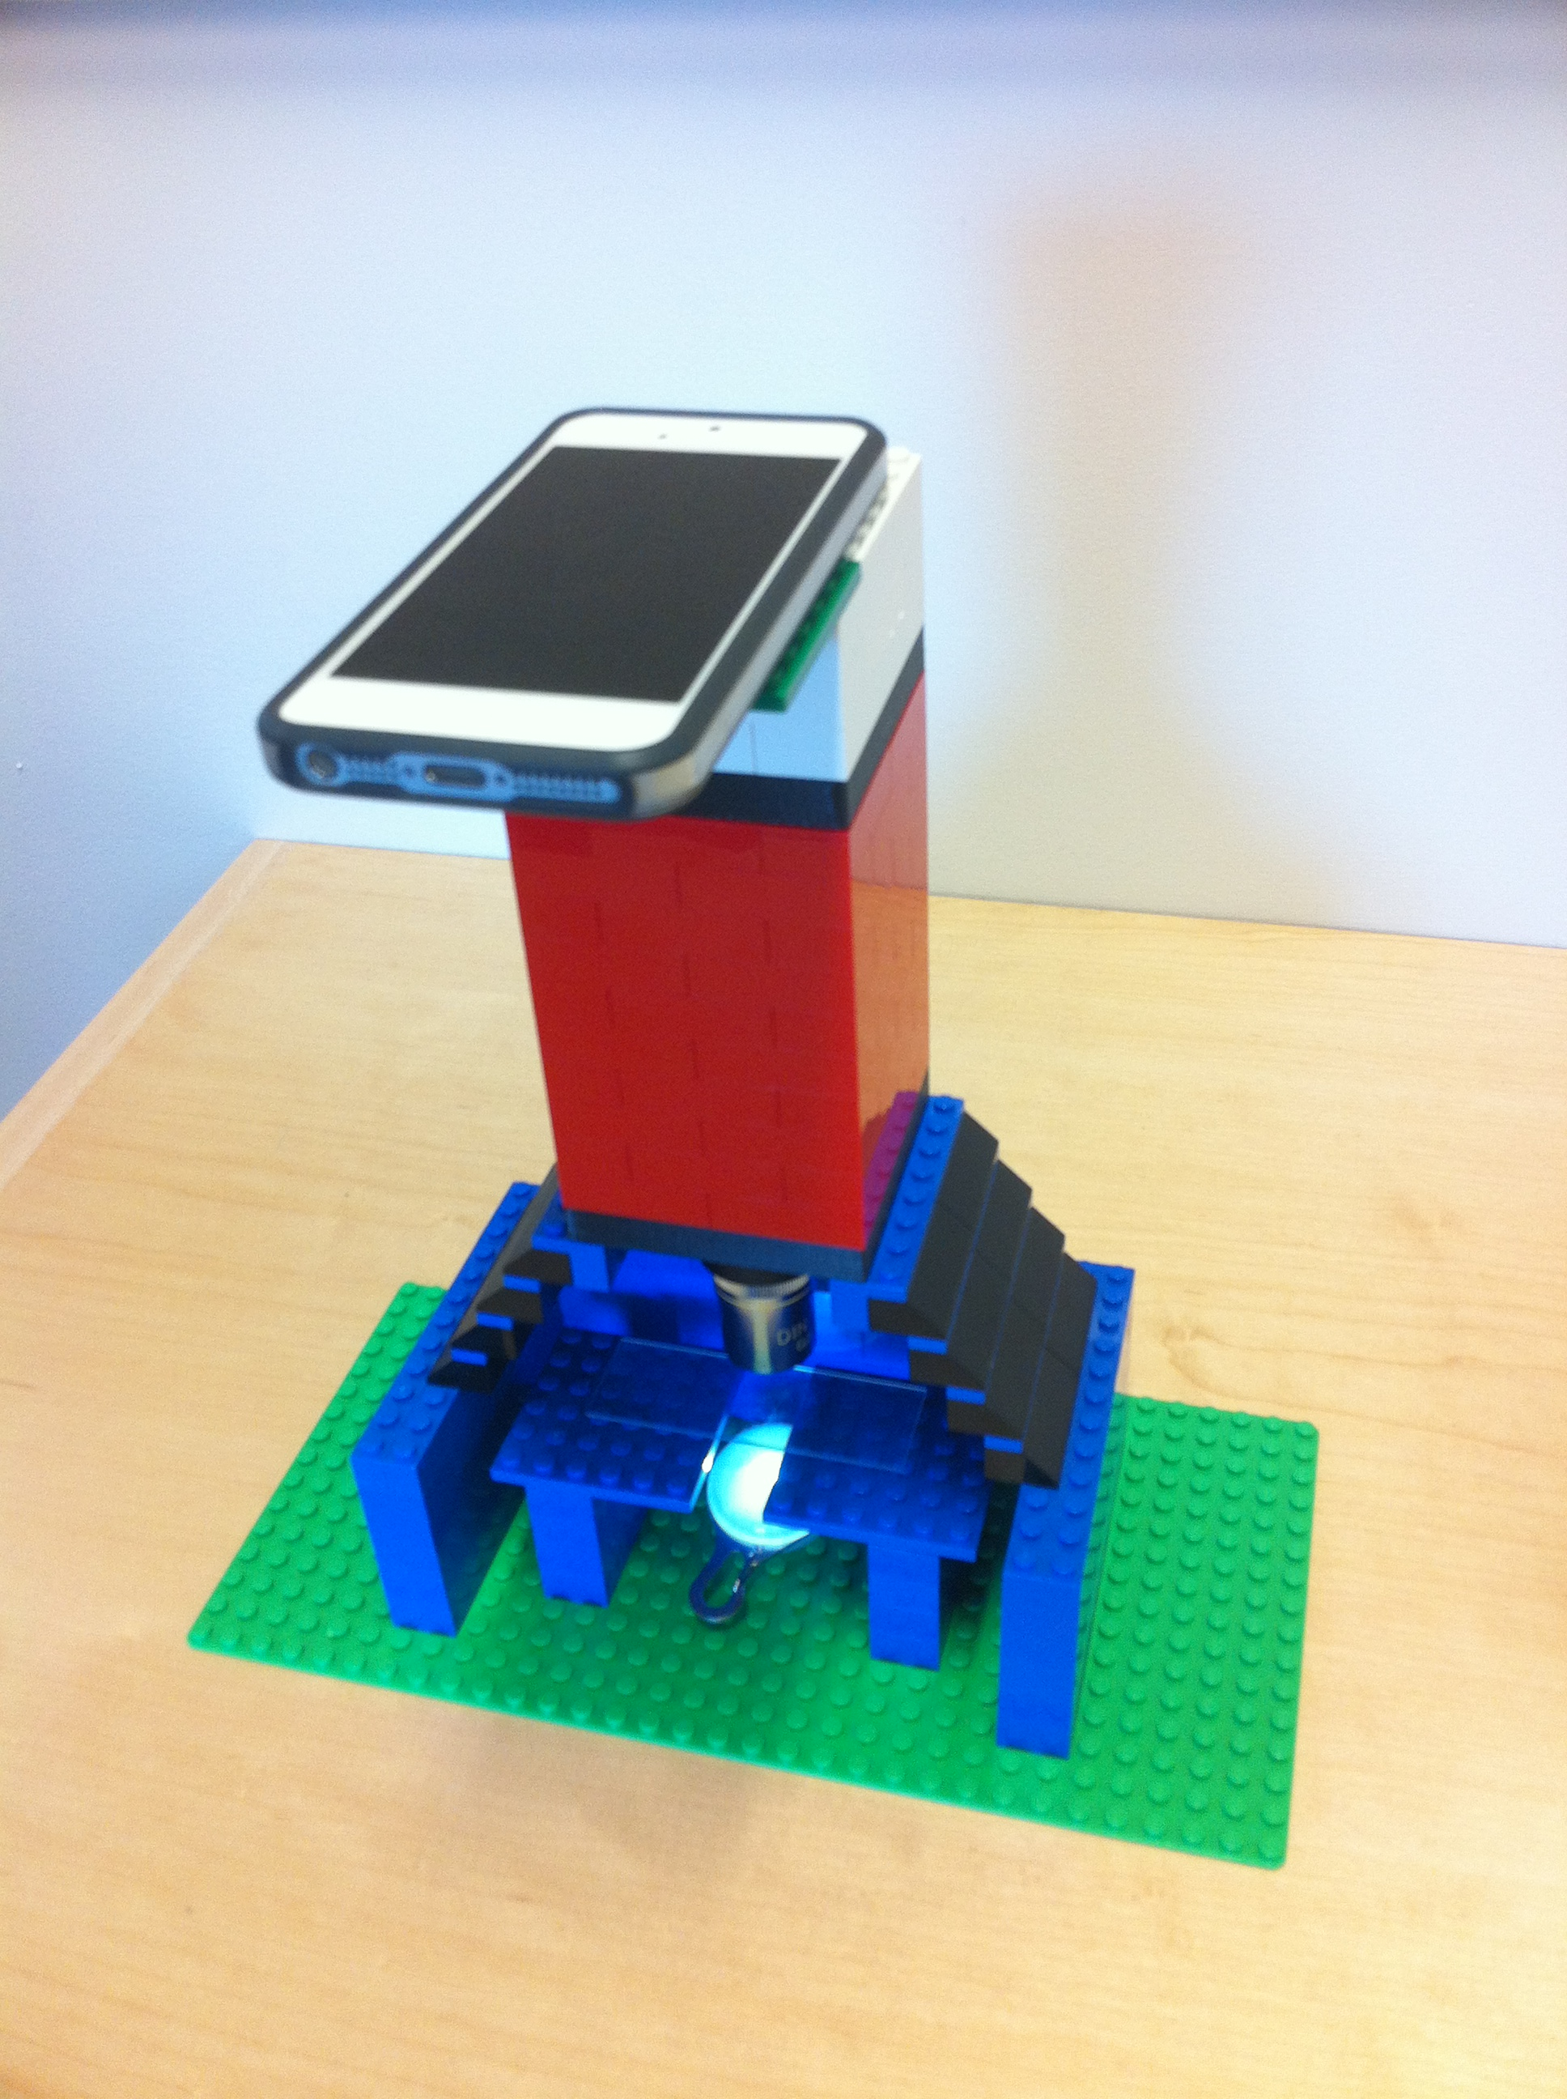
Cameras For Microscopy
Ryan McGorty
26 March 2013

Slide 2
Goals of this lecture
Understand what prevents the ideal camera from being a realty
Understand sources of noise in digital imaging
Decipher meaning of camera specification sheets
Understand basic architecture of digital sensors

Slide 3
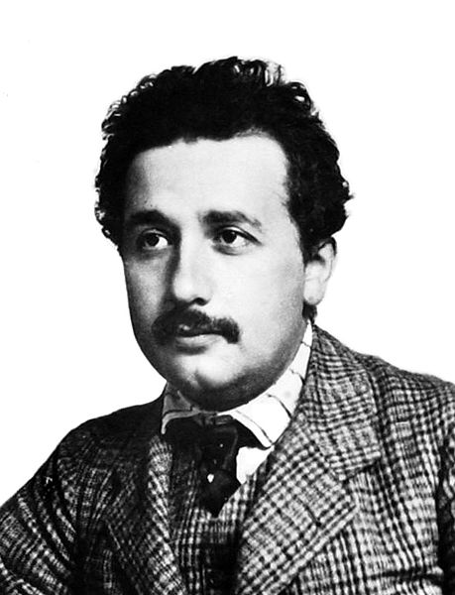
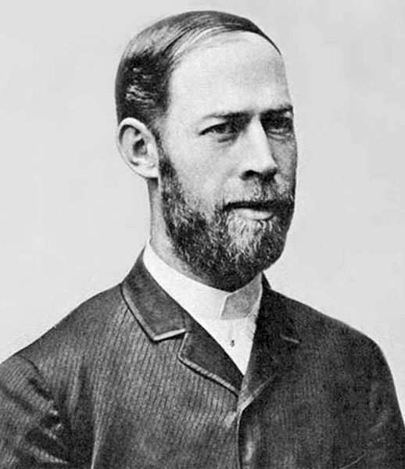
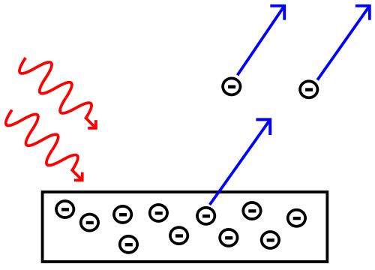
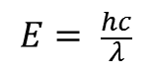
How image sensors sense an image
1. Need way to detect photons
Photoelectric Effect
Einstein
Hertz: observed in 1887
$$E= \frac{hc}{λ}$$
For silicon, need ≈ 1.14 eV to release an electron
So need λ < 1100 nm

Slide 4
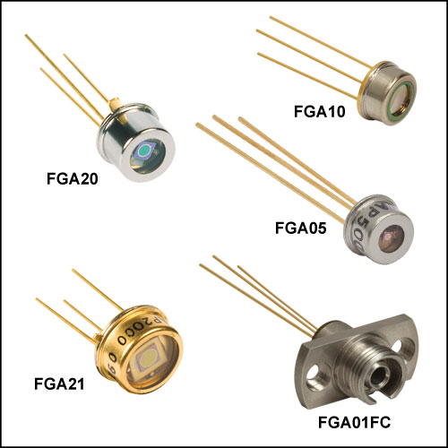
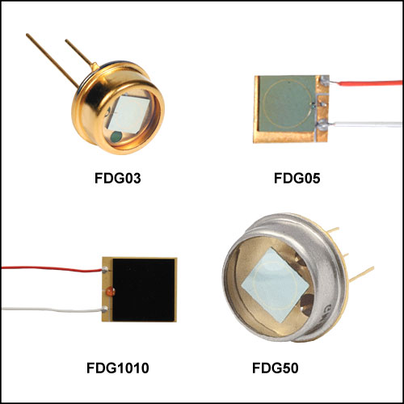
Point Detectors
Photodiodes
Photons will generate electron (photoelectron)
But detecting few electrons is hard
Need way to amplify the signal
e⁻
Photon
Notes:
Photon generates electron, but few electrons are hard to detect

Slide 5
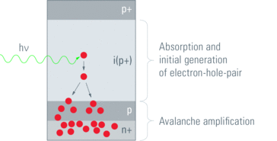
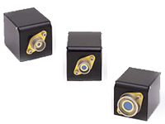
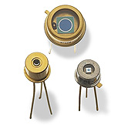
Point Detectors
Avalanche Photodiode (APD)
Initial e⁻ becomes amplified through impact ionization
Gains of 100 to 1000
Image from http://www.leica-microsystems.com/science-lab/sensors-for-true-confocal-scanning/

Slide 6
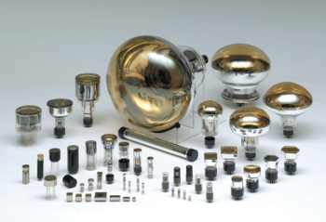
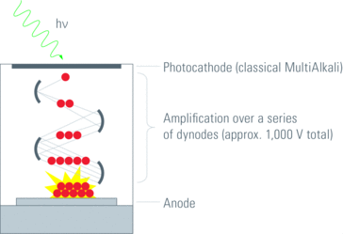
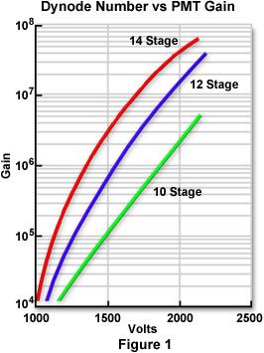
Point Detectors
Photomultiplier Tube (PMT)
Used widely in confocals
High linearity
Fast response
High gain
Image from http://www.leica-microsystems.com/science-lab/sensors-for-true-confocal-scanning/

Slide 7
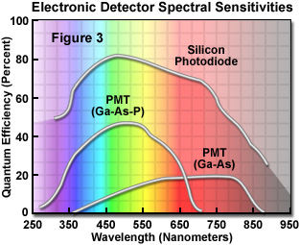
How well are photons detected?
Quantum Efficiency
Notes:
Higher gain doesn’t necessarily mean higher sensitivity

Slide 8
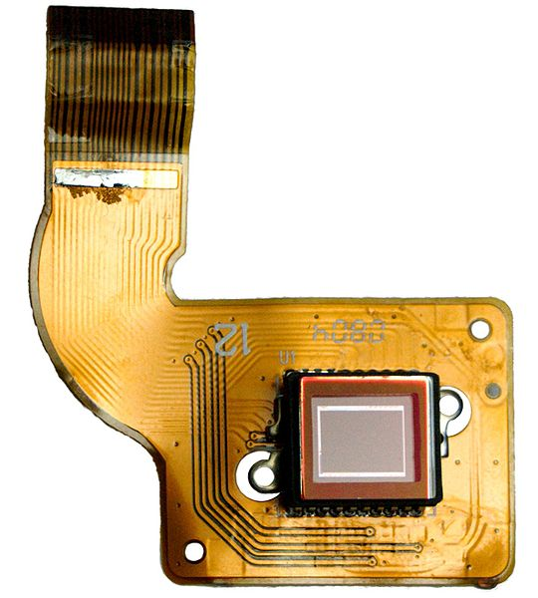
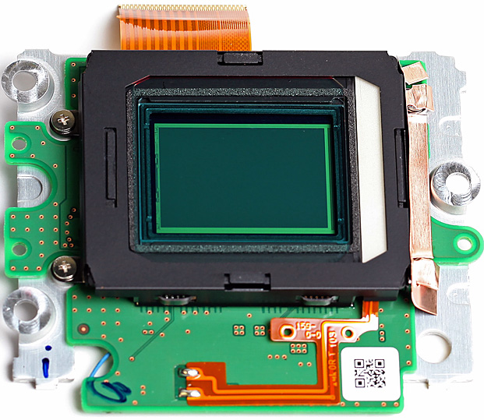
How image sensors sense an image
2. Must detect photons over an array of pixels
CCD
CMOS

Slide 9
How image sensors sense an image
3. Electrons generated in each pixel must be read out
CCD
CMOS
Serial devices where each pixel’s charge is read out one at a time
Each pixel contains amplifier electronics so read out can be much faster

Slide 10
What is meant by “read out”?
Photons
× QE
Analog-Digital Converter (ADC)
Amplifier
Photoelectrons
Voltage
10011101
Bit Depth | Number of gray levels
8 | 2⁸ = 256
10 | 2¹⁰ = 1024
12 | 2¹² = 4096
14 | 2¹⁴ = 16384
16 | 2¹⁶ = 65536

Slide 11
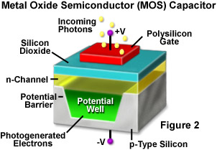
CCD Detectors
Charge-Coupled Device
Invented at Bell Labs in 1970
2009 Nobel Prize in Physics
Widely used in TV, medical, astronomy cameras
Array of light sensitive MOS capacitors (pixels)
Incoming light generates electrons which are captured in a potential well
Electrodes, or gates, move the charge
Image from http://www.microscopyu.com/articles/digitalimaging/ccdintro.html

Slide 12
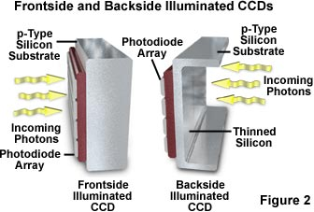
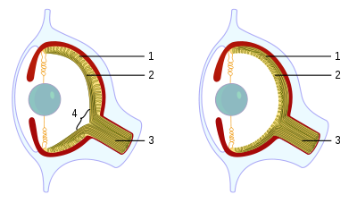
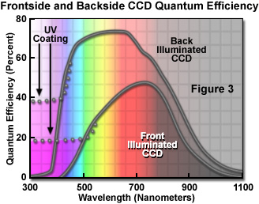
Front or Back Illuminated
Traditional, front-illuminated have wiring in front of photosensitive region
This blocks some light, reducing QE
Back-illuminated CCDs:
Back side of the CCD is etched to 10-15 microns
More fragile and costly, but higher QE
Vertebrate
Octopus
Retina
Nerves
Optic nerve
http://en.wikipedia.org/wiki/Cephalopod_eye
From http://learn.hamamatsu.com/articles/quantumefficiency.html

Slide 13
CCD Detectors
e⁻

Slide 14
CCD Detectors
Three-phase clocking method
Photoelectrons from each pixel must be shuttled to the readout area to be amplified, converted to a voltage and then a digital number.

Slide 15
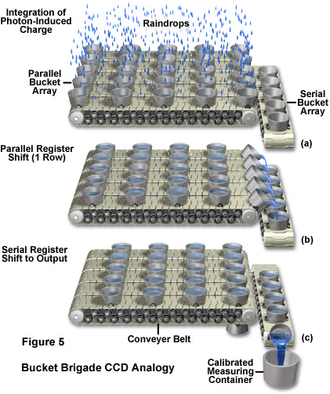
Bucket brigade analogy for read out
Rain accumulates in buckets
Rows of buckets shifted to readout row
Readout row shifted bucket-by-bucket to measuring device
Unless rain stops, last bucket to be read out will have much more water than the first

Slide 16
Transferring photoelectrons out
Full frame
Full area of CCD collects light
During readout, shutter must block light
Incoming light
Shutter

Slide 17
Transferring photoelectrons out
Full frame
Frame transfer
Half of CCD collects light; other half is for storage
After exposure, charge transferred to storage half and read out
Incoming light
Light blocking mask

Slide 18
Transferring photoelectrons out
Full frame
Frame transfer
Interline transfer
Alternating columns of light sensitive and storage/transfer pixels
Photosensitive pixels collect charge; charge shifted to neighboring columns and read out
Incoming light

Slide 19
Transferring photoelectrons out
Full frame
Frame-transfer
Interline
Output amplifier
Readout register
Pros:
Nearly all of CCD area is usable
Cons:
Frame rates limited by shutter speed
Pros:
Fast: exposure and readout occur simultaneously
Cons:
Half of CCD is not light sensitive
Pros:
Fast: shift of only one pixel needed to store charge
Cons:
Reduced fill factor (abated with microlenses)

Slide 20
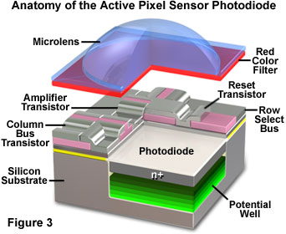
CMOS Detectors
Complementary Metal Oxide Semiconductor
Transistors in each pixel convert charge to voltage
More can be done within a pixel meaning frame read out can be faster
Fabricated much like microprocessors and RAM so are cheaper to make
Used in webcams, phone cameras since they use less power
Image from http://www.olympusmicro.com/primer/digitalimaging/cmosimagesensors.html

Slide 21
CMOS read out
Each pixel has at least 3 transistors
For converting charge to voltage; resetting pixel; transferring voltage
Voltage transferred along columns to amplifiers and ADCs
Each row is then read out to memory
ADC
ADC
ADC
ADC

Slide 22
CMOS read out
Global vs. Rolling Shutter
Rolling Shutter:
Exposure start is delayed between each row
Readout goes row by row
Offset time between rows as low as 10 μs
Exposure starts
Exposure starts
Exposure starts
ADC
ADC
ADC
ADC

Slide 23
CMOS read out
Global vs. Rolling Shutter
Rolling Shutter:
Exposure start is delayed between each row
Readout goes row by row
Offset time between rows as low as 10 μs
Readout starts
Readout starts
Readout starts
ADC
ADC
ADC
ADC

Slide 24
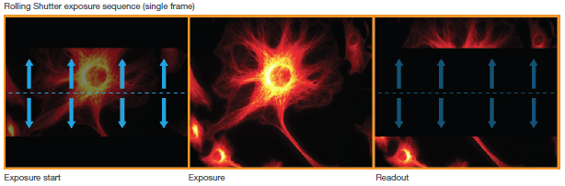
CMOS read out
Global vs. Rolling Shutter
Rolling Shutter:
Exposure start is delayed between each row
Readout goes row by row
Offset time between rows as low as 10 μs
http://www.andor.com/pdfs/literature/Tech_Note_Rolling_Global_Shutter.pdf

Slide 25
CMOS read out
Global vs. Rolling Shutter
Rolling Shutter:
Exposure start is delayed between each row
Readout goes row by row
Offset time between rows as low as 10 μs
Global Shutter:
All pixels begin and end exposure at same time
Requires extra transistor in each pixel
Higher read noise
Half the maximum frame rate

Slide 26
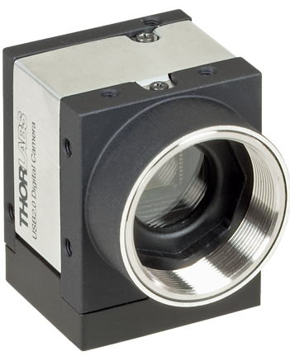
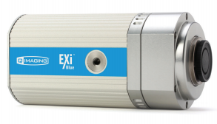
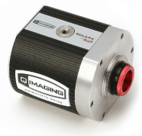
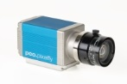
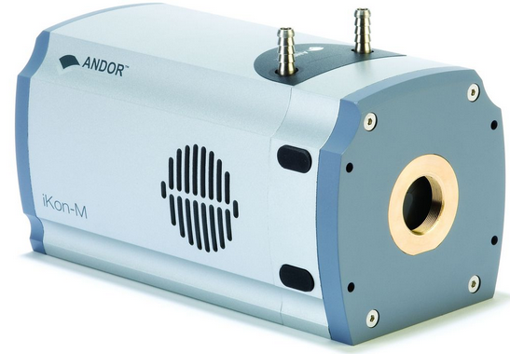
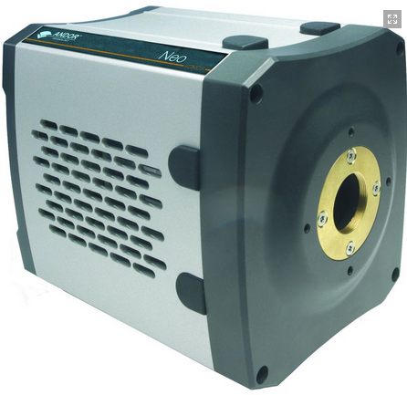
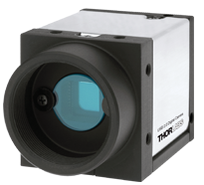
Many options
CCD
CMOS

Slide 27
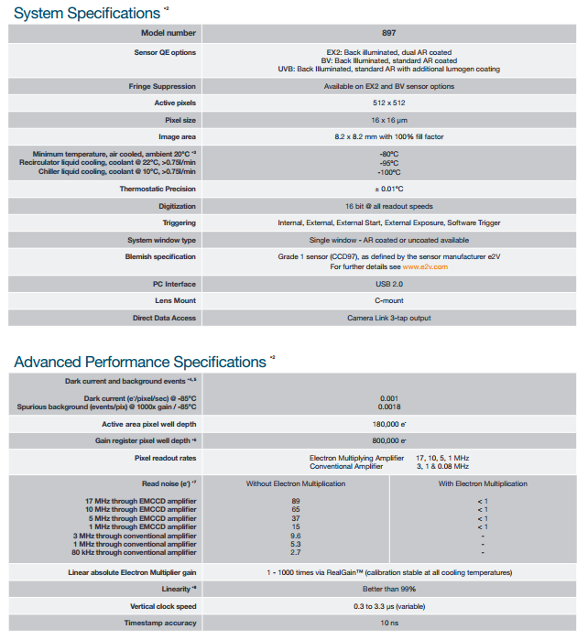
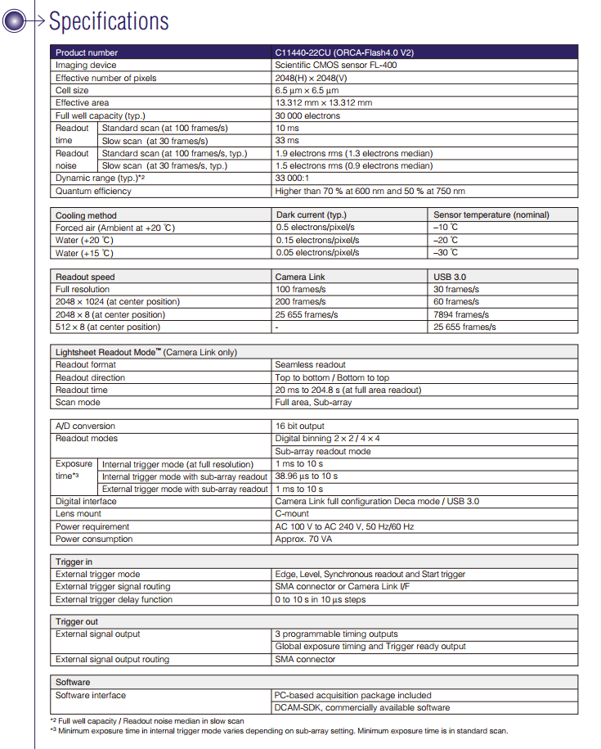
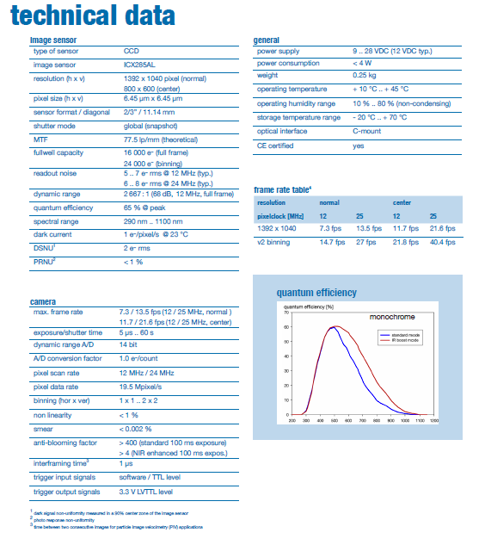
Camera Spec Sheets

Slide 28
The Ideal Camera
High resolution
Optically resolvable features span a couple pixels
Large area
Covers field of view
Linear response
Twice the photons gives twice the output
Uniform response
Same response no matter where photon lands
Fast
Can capture dynamic processes
High sensitivity
All photons get measured

Slide 29
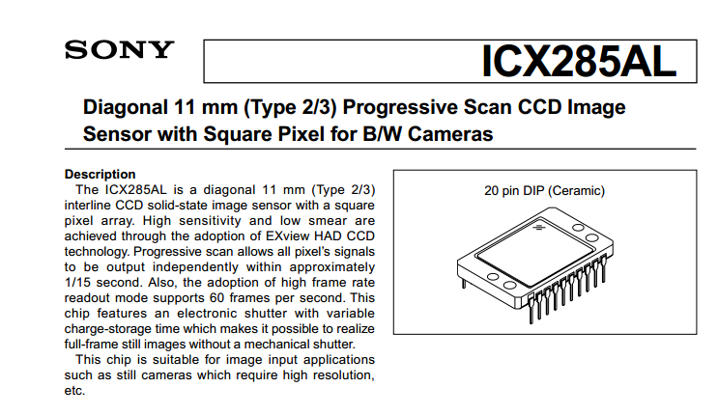
Going into the spec sheet
SONY Interline CCD chip
Notes:
Camera companies don’t generally make the chip sensor, only the electronics that surround it

Slide 30
Going into the spec sheet
Suppose you want 3 pixels per resolvable unit of 300 nm:
0.3 μm × M = 3 × 6.45 μm
M = 64.5×

Slide 31
Going into the spec sheet

Slide 32
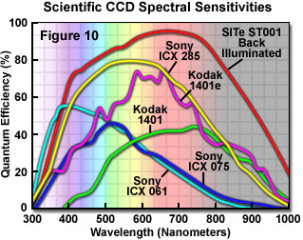
How well are photons detected?
Quantum Efficiency

Slide 33
Going into the spec sheet

Slide 34


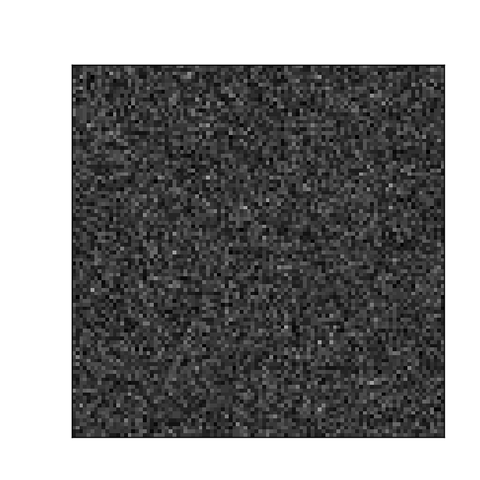



NOISE!
What is noise?
Uncertainty in measured signal
Looks like random fluctuations in intensity
$$\left\langle I\left(x,y\right)\right\rangle =1$$
$σ=0.032$
$$\left\langle I\left(x,y\right)\right\rangle =1$$
$$σ=0.099$$
$$\left\langle I\left(x,y\right)\right\rangle =1$$
$$σ=0.41$$

Slide 35
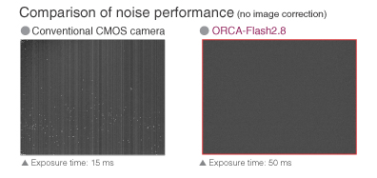
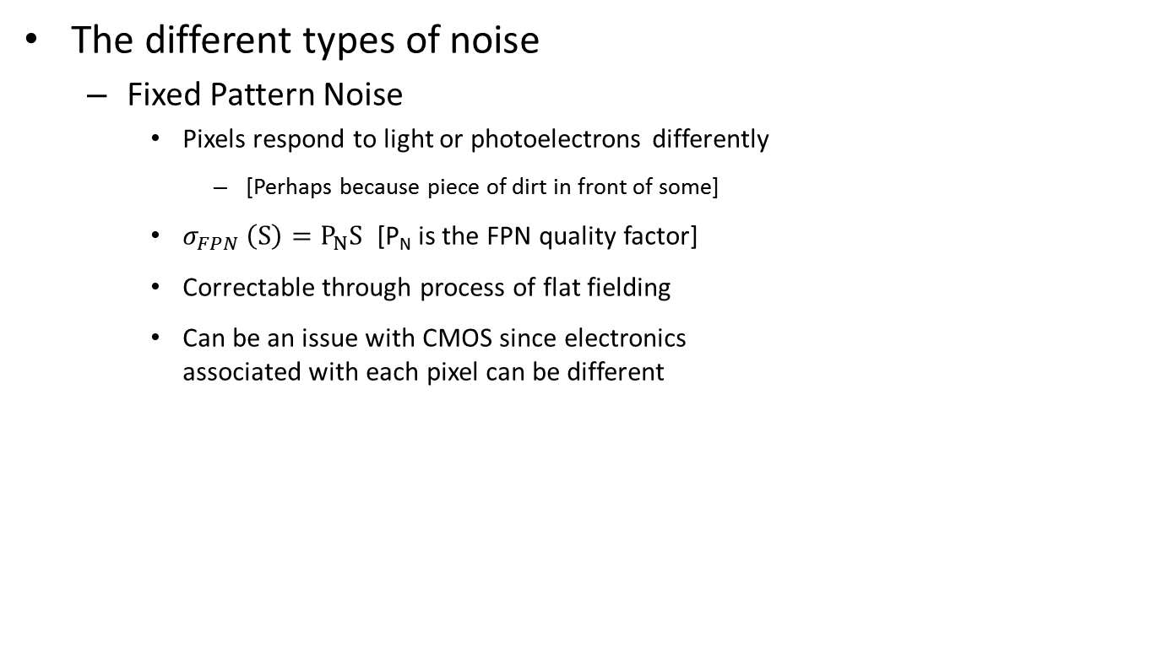
NOISE!
The different types of noise
Fixed Pattern Noise
Pixels respond to light or photoelectrons differently
[Perhaps because piece of dirt in front of some]
$σ_{FPN} \left(S\right)=P_{N}S$ [P_{N} is the FPN quality factor]
Correctable through process of flat fielding
Can be an issue with CMOS since electronics associated with each pixel can be different

Slide 36
NOISE!
The different types of noise
Fixed Pattern Noise
Dark Noise
Temperature dependent; reduced by cooling camera
Clock-induced Charge Noise
As charge gets moved around, new electrons can be generated

Slide 37
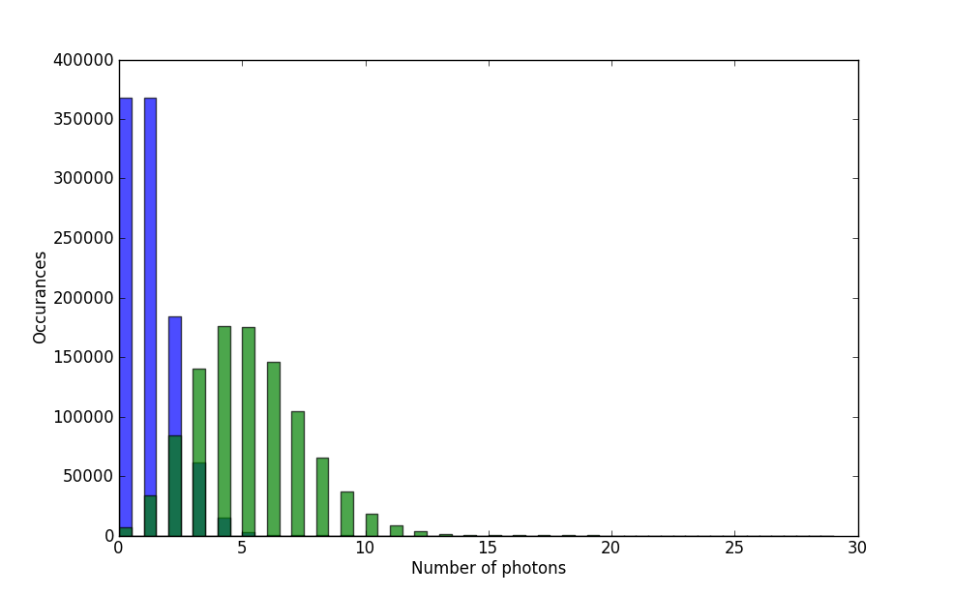
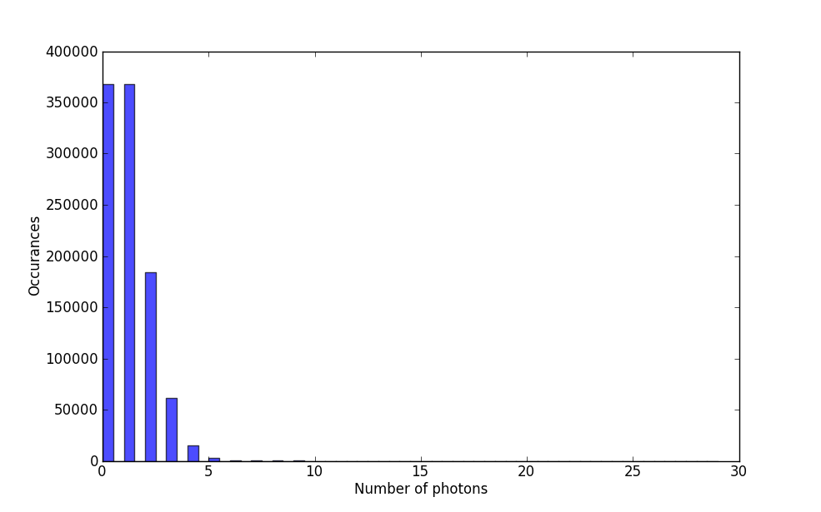
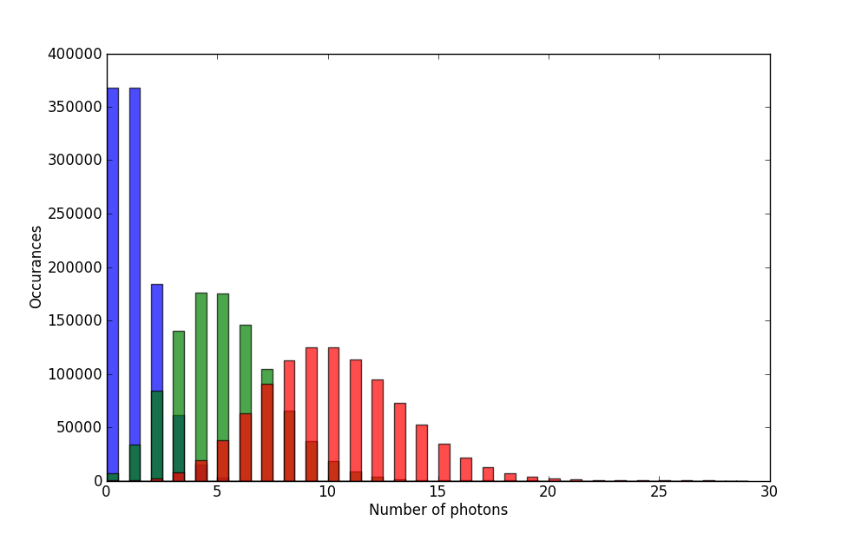
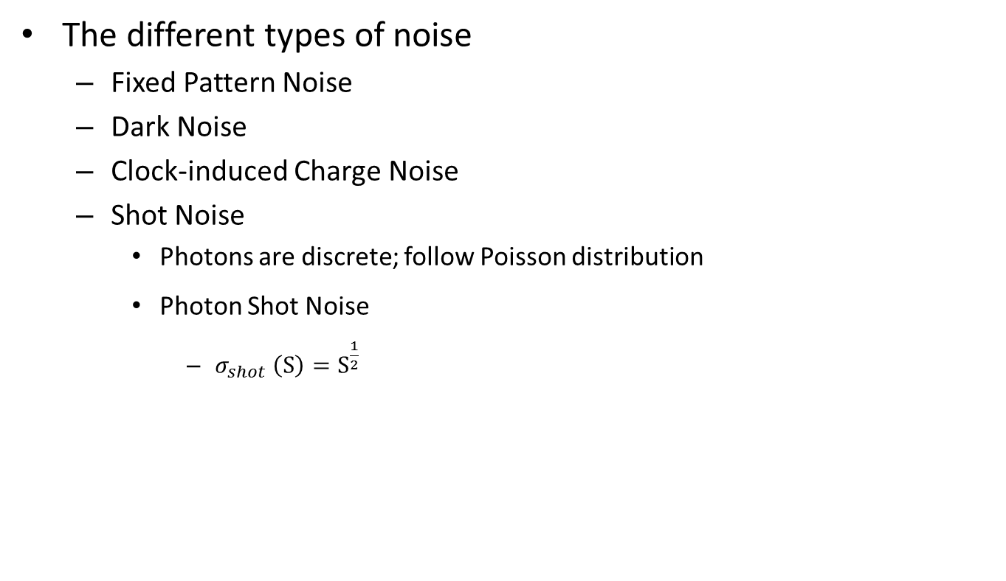
NOISE!
The different types of noise
Fixed Pattern Noise
Dark Noise
Clock-induced Charge Noise
Shot Noise
Photons are discrete; follow Poisson distribution
Photon Shot Noise
$σ_{shot} \left(S\right)=S^{\frac{1}{2}}$
Photon distribution on 1 million pixels
Average of 1 photon per pixel
Average of 5 photons per pixel
10 photons/pixel

Slide 38
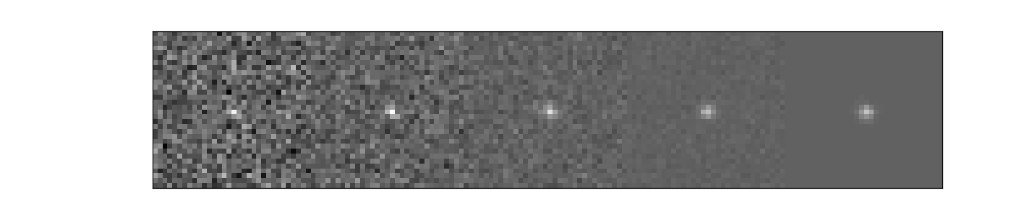
NOISE!
The different types of noise
Fixed Pattern Noise
Dark Noise
Clock-induced Charge Noise
Shot Noise
Read Noise
Not a function of signal. Due to electronics converting charge to voltage
Generally increases with increased readout speed
Sets the minimum signal that can be detected
Decreasing read noise
Same signal.

Slide 39
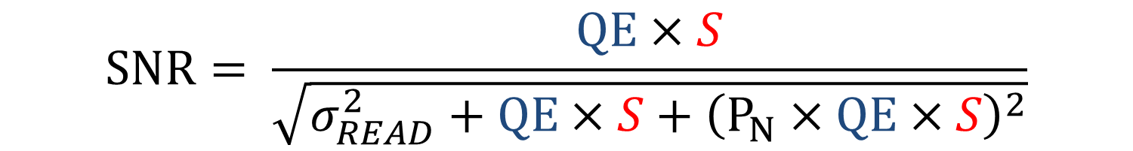
NOISE!
The different types of noise
Fixed Pattern Noise
Dark Noise
Clock-induced Charge Noise
Shot Noise
Read Noise
Signal to Noise Ratio
$$SNR= \frac{QE×S}{\sqrt{σ_{READ}^{2}+QE×S+{\left(P_{N}×QE×S\right)}^{2}}}$$

Slide 40
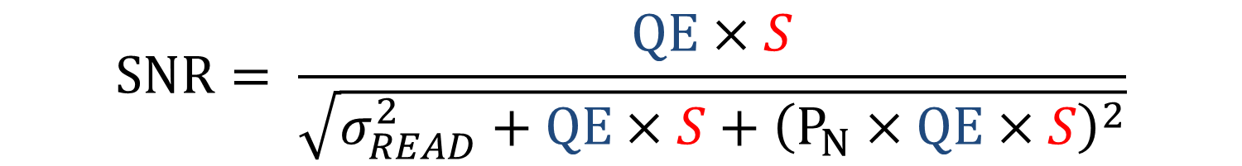
NOISE!
Signal to Noise Ratio
$$SNR= \frac{QE×S}{\sqrt{σ_{READ}^{2}+QE×S+{\left(P_{N}×QE×S\right)}^{2}}}$$
Image from Photon Transfer by James R. Janesick

Slide 41
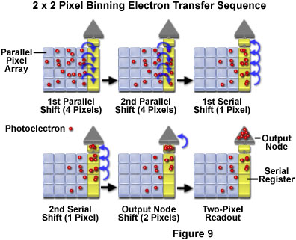
How do you optimize SNR?
Choose a camera that has:
High QE
Back illuminated
Low read noise
Cooling ability
Spatial uniformity
When imaging:
Go at slowest speeds
Use largest pixel size
Binning
Binning increases the SNR by a factor of the sqrt of number of pixels binned

Slide 42
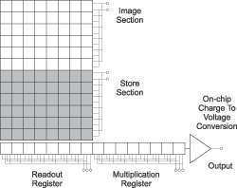
Nearly eliminating read noise: EMCCDs
Amplifies signal to push it well above read noise
In CCDs: rows gets transferred to edge to readout register
EMCCDs add an electron multiplication (EM) register
As charge is transferred through EM register, impact ionization increases charge on order of 100-1000×
Image from http://www.andor.com/learning-academy/electron-multiplying-ccd-cameras-the-technology-behind-emccds

Slide 43
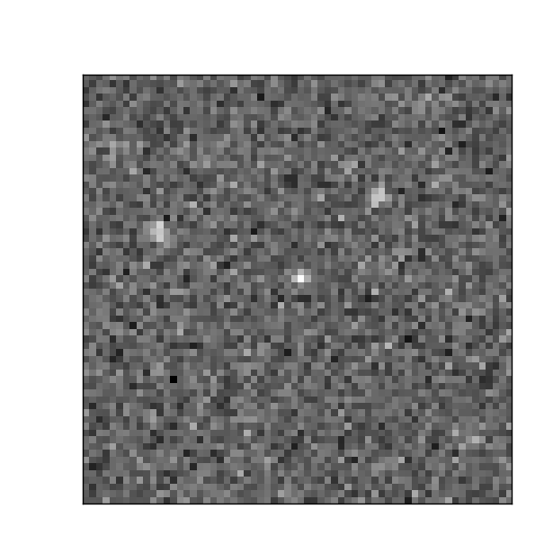
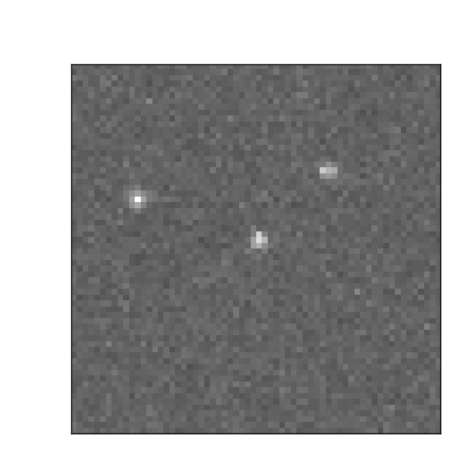
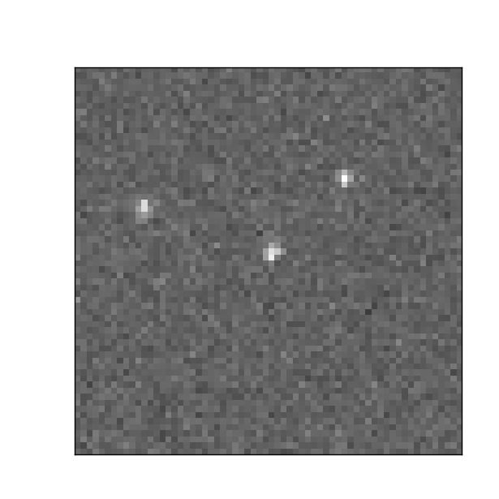

Noise in EMCCDs
Read noise = 10 e⁻
Read noise = 0.5 e⁻
Read noise = 0.5 e⁻ Plus EM associated noise, F_{n}
$$SNR= \frac{QE×S}{\sqrt{σ_{READ}^{2}/M^{2}+F_{n}^{2}×QE×S}}$$
Notes:
Simulation details: On av 300 photons per molecule. 10 photons/pixel background

Slide 44
A new option for when photons are few: sCMOS
“scientific” CMOS
Latest generation of CMOS cameras
Sensor split into top and bottom halves
Both are read out independently to increase speed
Each column as dual amplifiers and ADC
For high and low gain readout to maximize dynamic range

Slide 45
NOISE!
Shot noise
Readout noise
Photons
× QE
Analog-Digital Converter (ADC)
Amplifier
Photoelectrons
Voltage
10011101
Clock induced charge noise
EM noise factor
EM Gain
Fixed pattern noise
Dark noise

Slide 46

Measuring noise
Steps to generate photon transfer curve:
Record several sequences of frames at various illumination levels starting with completely dark
Use homogenous illumination,
Or correct for inhomogeneity as well as fixed pattern noise by subtracted neighboring frames
Plot standard deviation of signal versus mean signal
$σ^{2}\left(I\left(x,y\right)\right)=A \left\langle I(x,y)\right\rangle +σ_{READ}^{2}$

Slide 47

sCMOS
Noise includes shot noise and read noise. Fixed pattern noise eliminated by taking the difference of consecutive frames.
Slope of ½
Slope of 0

Slide 48



sCMOS
Slope of 0
Images show variance on a log scale

Slide 49

sCMOS
Fixed pattern noise is now included.
Slope of 1
Slope of ½

Slide 50




sCMOS
Images show average of 400 frames

Slide 51
sCMOS
Fixed Pattern Noise
Shot Noise
Read Noise
By looking at shot noise vs. signal: ADU conversion is about 2.2 DN/e⁻
Read noise: noise vs. signal levels out around 3.8 DN = 1.7e⁻
Fixed pattern noise: about 1.7% of signal

Slide 52

sCMOS
Read noise: noise vs. signal levels out around 1.7e⁻

Slide 53

CCD
Fixed pattern noise and illumination inhomogeneity eliminated by taking the difference of consecutive frames.
Full well regime
Shot Noise
Read Noise
By looking at shot noise vs. signal: ADU conversion is about 1.0 DN/e⁻
Read noise: noise vs. signal levels out around 5 DN = 5 e⁻

Slide 54

EMCCD
ADU ≈ 10 DN/e⁻
ADU ≈ 5 DN/e⁻
ADU ≈ 0.1 DN/e⁻

Slide 55

EMCCD
Read noise ≈ 30 e⁻
Read noise ≈ 0.9 e⁻
Read noise ≈ 0.5 e⁻
When plotted in units of e⁻ rather than DN benefit of EM gain can be seen: read noise is effectively reduced by the amount of gain

Slide 56

All three cameras above read noise
Cross over between EMCCD and sCMOS

Slide 57


Going back to the spec sheet
N_{r} = 6 e-
QE ≈ 45% at ≈ 700nm
$$SNR= \frac{QE ×P}{\sqrt{QE ×P+ σ_{READ}^{2}}}$$

Slide 58
Going back to the spec sheet
Dark current: 1 e⁻/pixel/s @ 23 °C

Slide 59
Going back to the spec sheet
Dynamic range: 2,667:1
Read noise = 6 e⁻
Full well capacity = 16,000 e⁻
Dynamic range = 16,000/6 = 2667
Dynamic range A/D = 14 bit
Gray levels = 2¹⁴ = 16,384

Slide 60

Thanks!
For more information:
http://learn.hamamatsu.com/articles
http://www.microscopyu.com/articles/digitalimaging/index.html/
Photon Transfer by James Janesick

